Slide 1
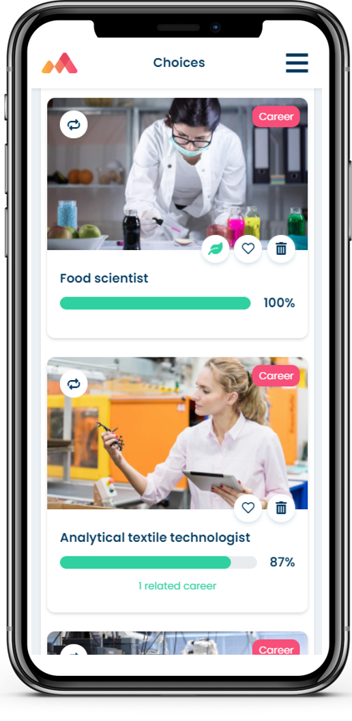
Introduction to Morrisby Careers Platforms
NAME

Slide 2
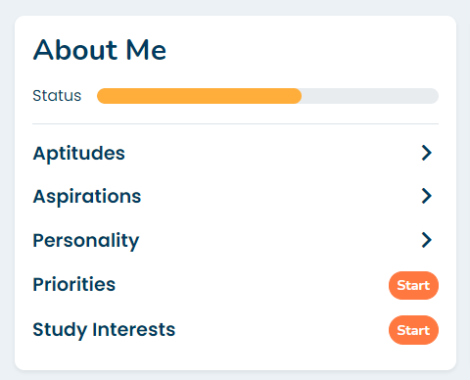
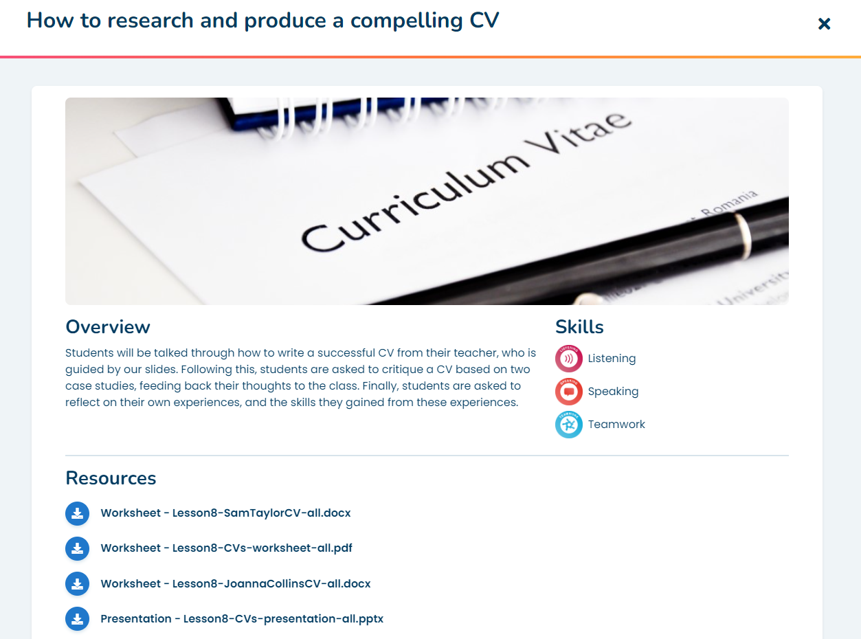

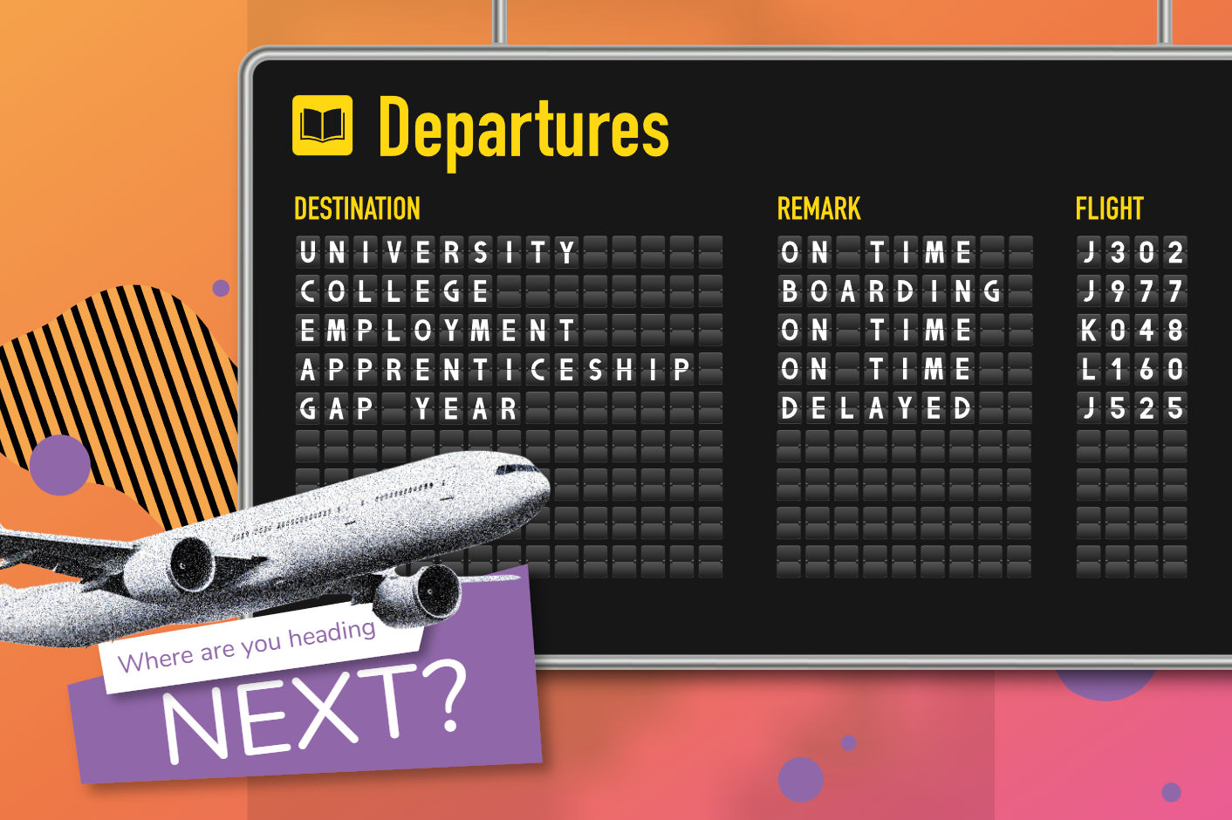
What is Morrisby?
A Whole school careers guidance platform consisting of:
Psychometric Assessments & Guidance
  Aptitudes
  Aspirations
  Priorities
  Study Interests
  Careers and Subject suggestions
Careers Lessons
  Age 11-18
  Covering the CDI Careers Learning framework
  Complete with lesson plans, worksheets and presentations
Careers Library
  Careers
  Subjects
  Universities
  Courses
  Apprenticeships
  Job search
Activity recording & Destinations
  Action planning
  Careers Activities
  Careers Interview
  Meetings
  Destinations Survey

Slide 3
Morrisby components
Per Student – Advanced psychometric toolset and careers/subject suggestions. Age 15+
School-wide careers platform with careers, courses, subjects, apprenticeships and careers planning, activity tracking/reporting
Morrisby Profile
For sixth forms – with advanced UCAS search, personal statement, academic references and learner passport
Morrisby Careers (The Core Module)
Add on to Morrisby Careers to manage work experience for Students, Employers
Higher
Work Experience

Slide 4

Morrisby Careers
Whole-school careers platform with school-wide activity tracking

Slide 5
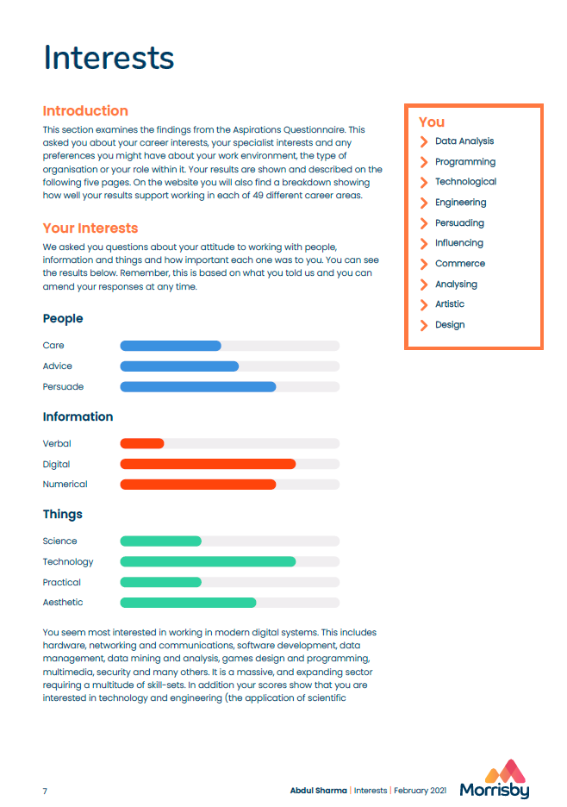
About me
Provides detailed insight for the student
Plan, with Favourites, Choices and Achievements
Suggestions (Careers, Subjects, Courses)
Choices, next steps

Slide 6
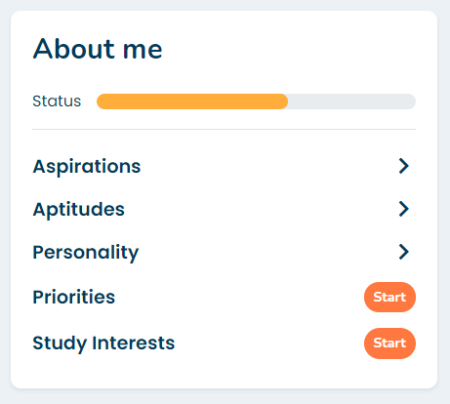
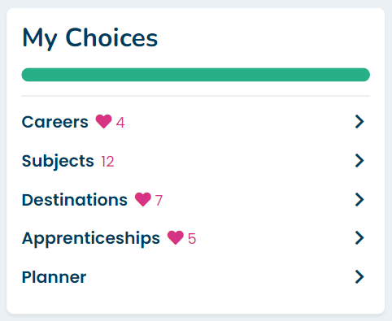
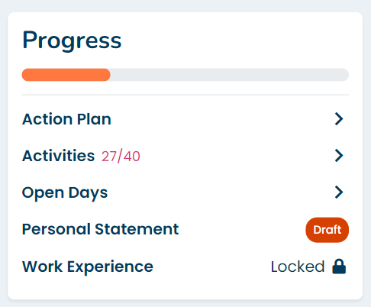

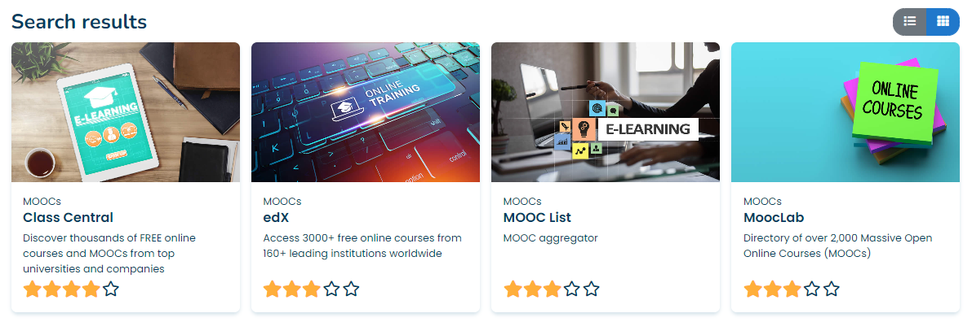
Student Journey – a joined up flow not a collection of tools
Self discovery through Psychometric assessments
Careers, Subjects, Courses and Apprenticeships
Action planning, Employability skills and Profile Interview
Plus hundreds of resources and sources of information

Slide 7
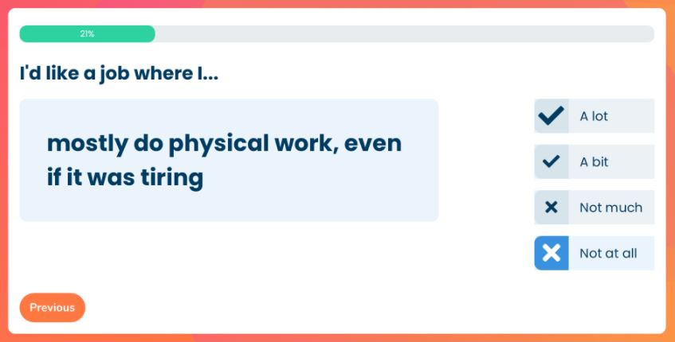
Aspirations

Slide 8
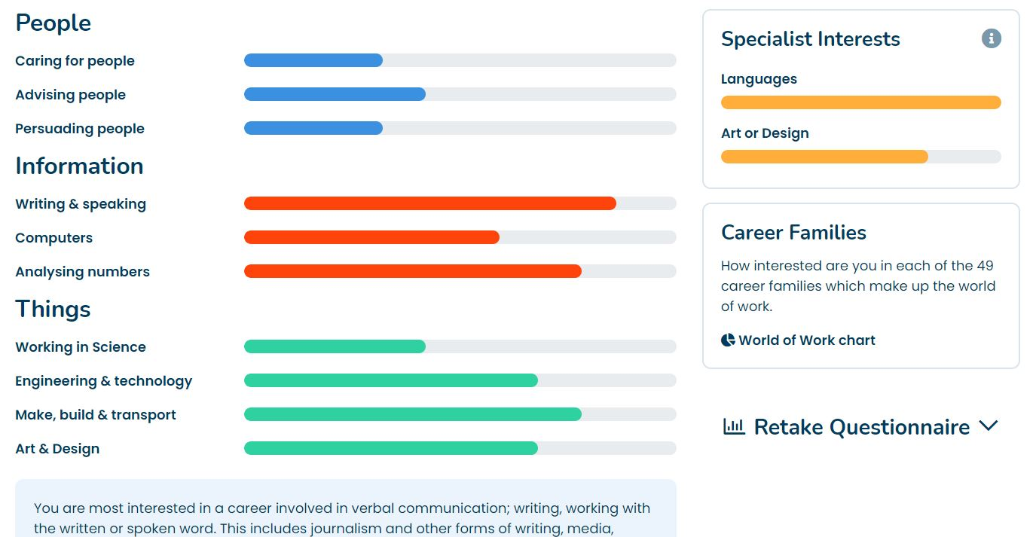
Aspirations - Outputs
Interests
  PEOPLE - Caring, Advising, Persuading
  INFORMATION - Verbal, Digital, Numerical
  THINGS - Science, Technology, Practical, Aesthetic
Specialist Interests (Talent areas)
  Sport, Music, Art, Languages, Performance
Career Families: “World of Work”
Work Style
  Organisational Role
  Style: Independence, Ambitious, Industrious, Leadership, Initiative
Workplace (environment)
  Active, Outdoors, Indoors, Public

Slide 9
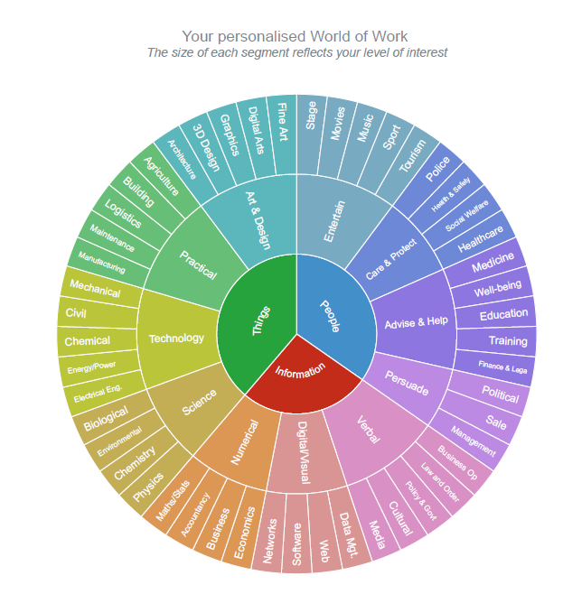

Slide 10
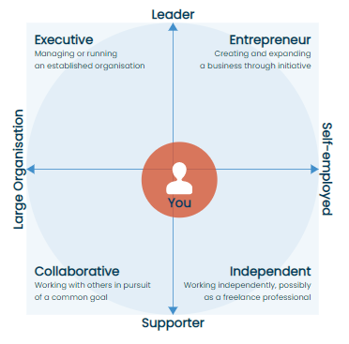
Work Style: Organisational role
The type of organisation, and role in that organisation that a person is best suited to
EXECUTIVE: a manager with responsibility for running an established organisation
COLLABORATIVE: a person who works with others to support the common purpose of an organisation
ENTREPRENEUR: the creator of a business enterprise who expands it through initiative and risk taking
INDEPENDENT: those who work independently in areas such as trades and crafts as well as freelance professionals

Slide 11
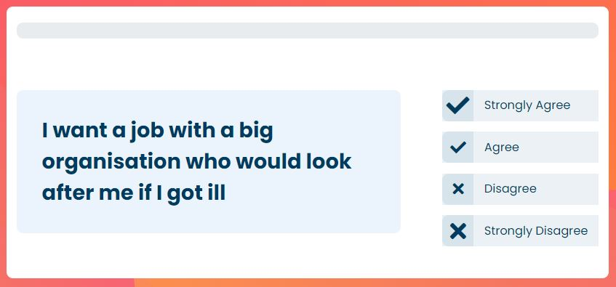
Priorities

Slide 12
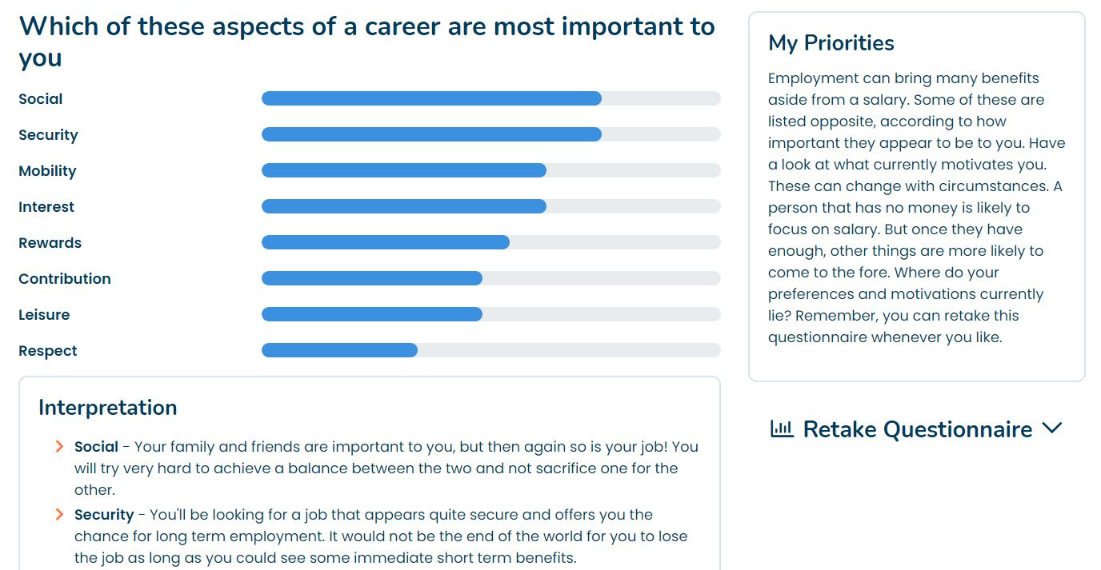
Priorities
8 scale ‘round robin’ questionnaire:
Security: Is the security of a stable job/career important?
Respect: How much do you want to be appreciated by others?
Contribution: Do you want to do a worthwhile job that might improve the lives of others?
Social: Does your job need to give you time to spend with family/friends
Interest: How much do you need to be interested in the work itself?
Rewards: Is the amount you are paid of primary importance?
Leisure: ‘Work to live’ or ‘live to work’?
Mobility: How prepared are you to move away, for the right role?

Slide 13
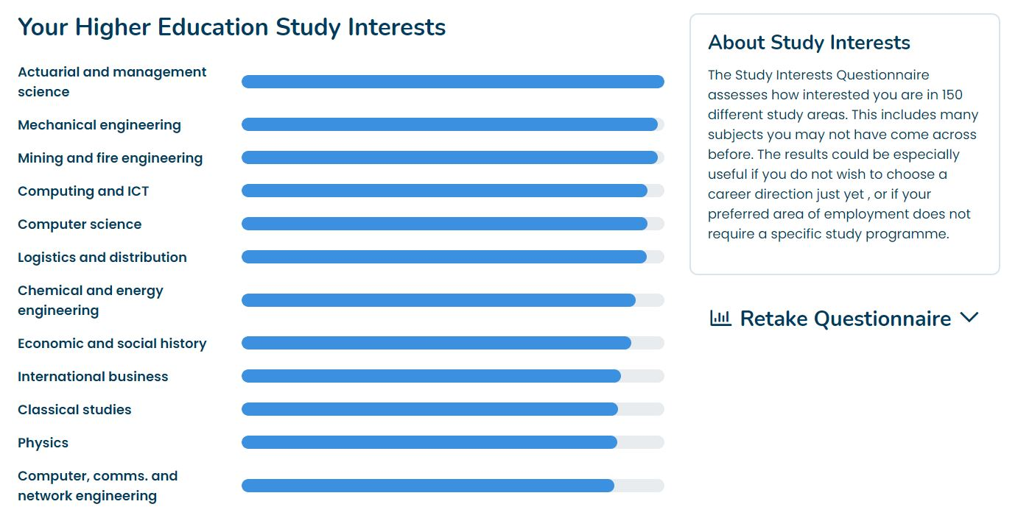
Study Interests
Optional questionnaire
Suggest higher education subjects
Assesses your level of interest in 150 study areas
Widens Client’s understanding of higher education subject options

Slide 14
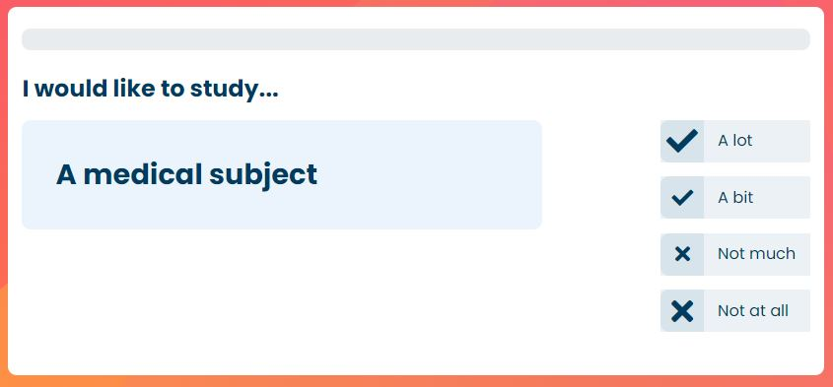
Study Interests

Slide 15
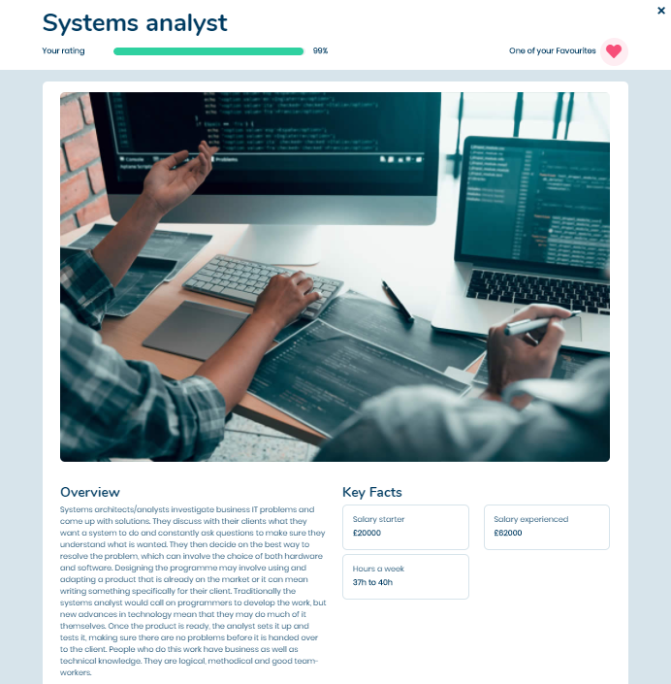

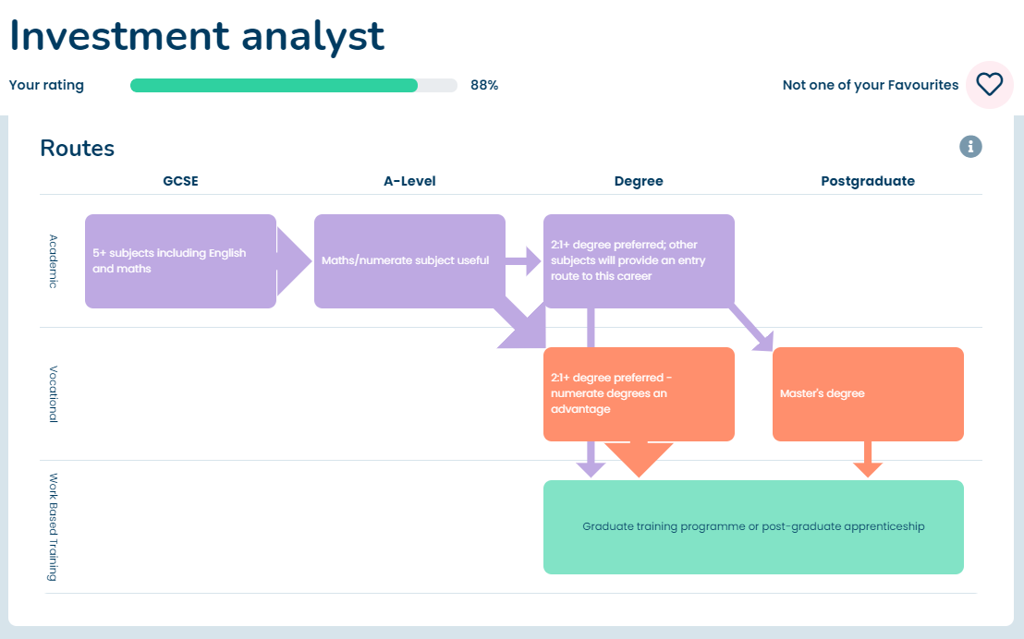
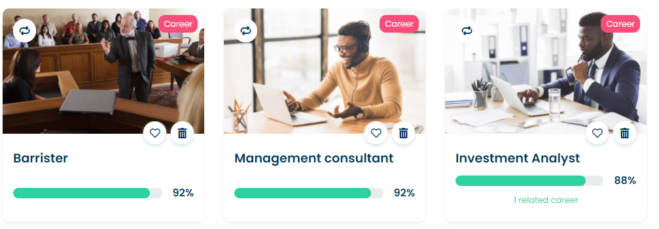
My Choices - Career suggestions
Detailed information
Route to that career
Required qualifications
Based on profile and qualifications
Over 600 in the library
Links to live job vacancies

Slide 16
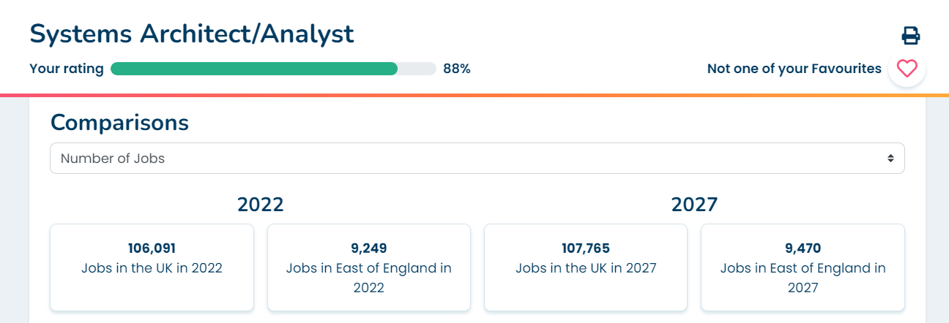
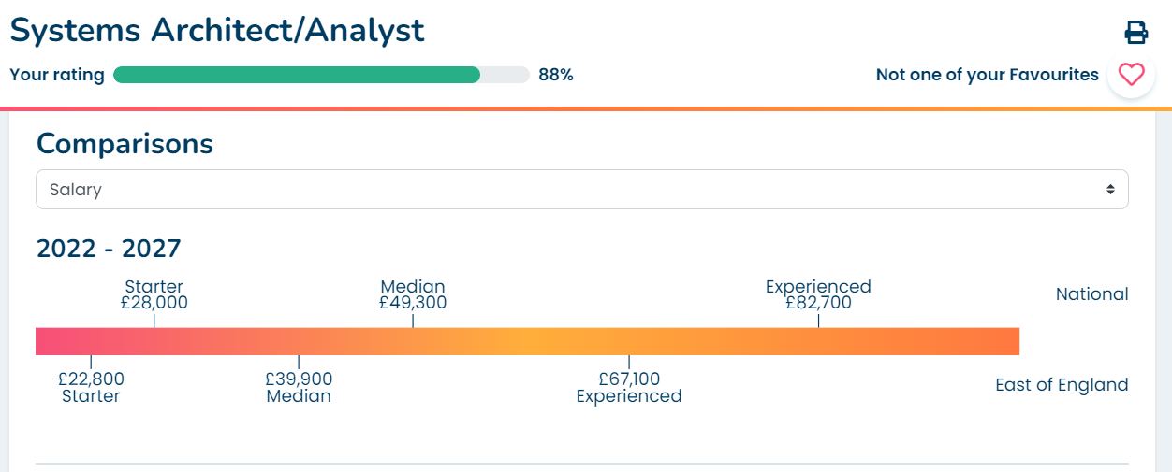
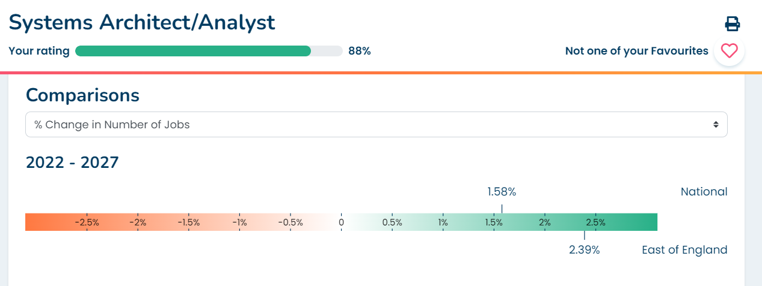
Regional LMI
Number of jobs
Rate of change
Salary comparisons
Covering English Regions, Scotland and Wales

Slide 17
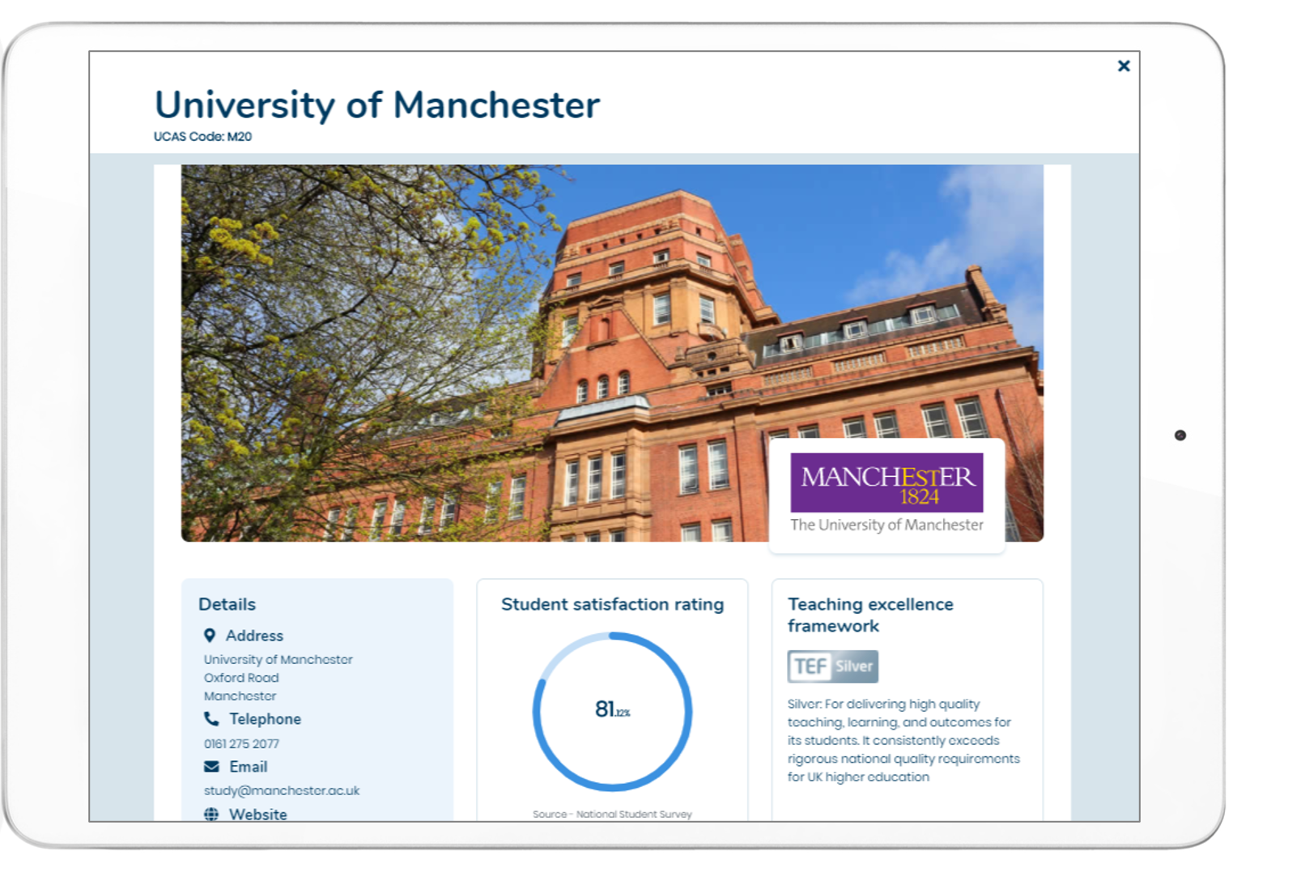
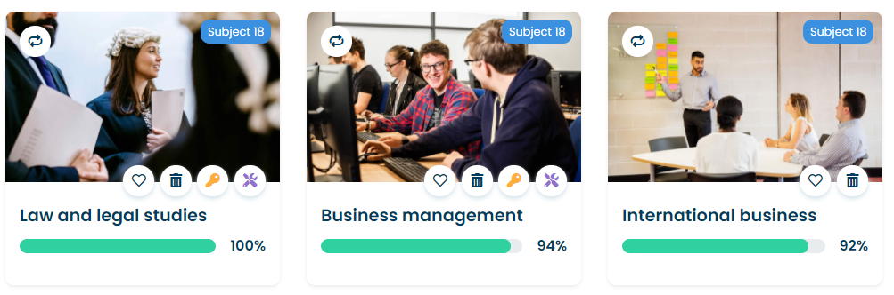
My Choices – Subjects and Universities
Subjects matched to Profile.
Detailed information including entry criteria and Tariff
Course search with links to University website and UCAS pages

Slide 18

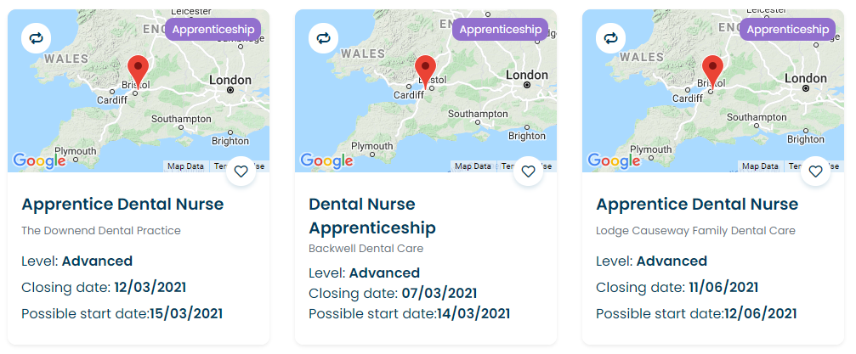
My Choices - Apprenticeships & vocational
Vocational subject suggestions
Live apprenticeship data updated daily
Direct link to the “Apply” page

Slide 19
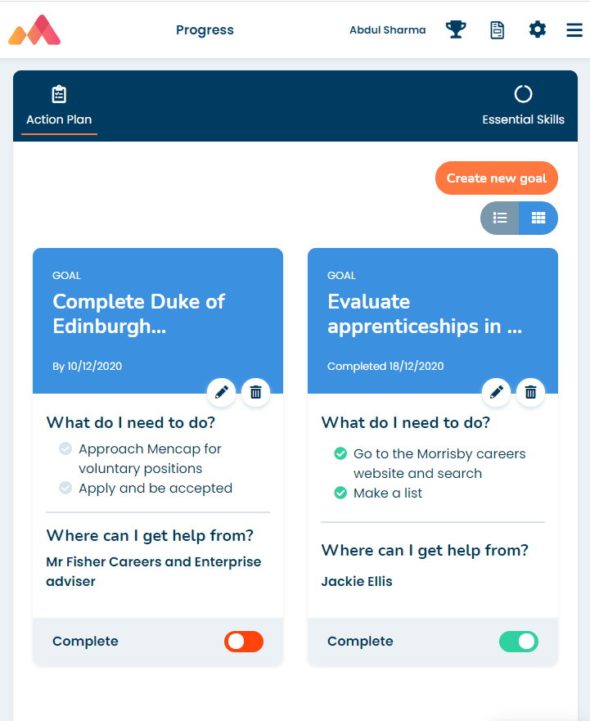
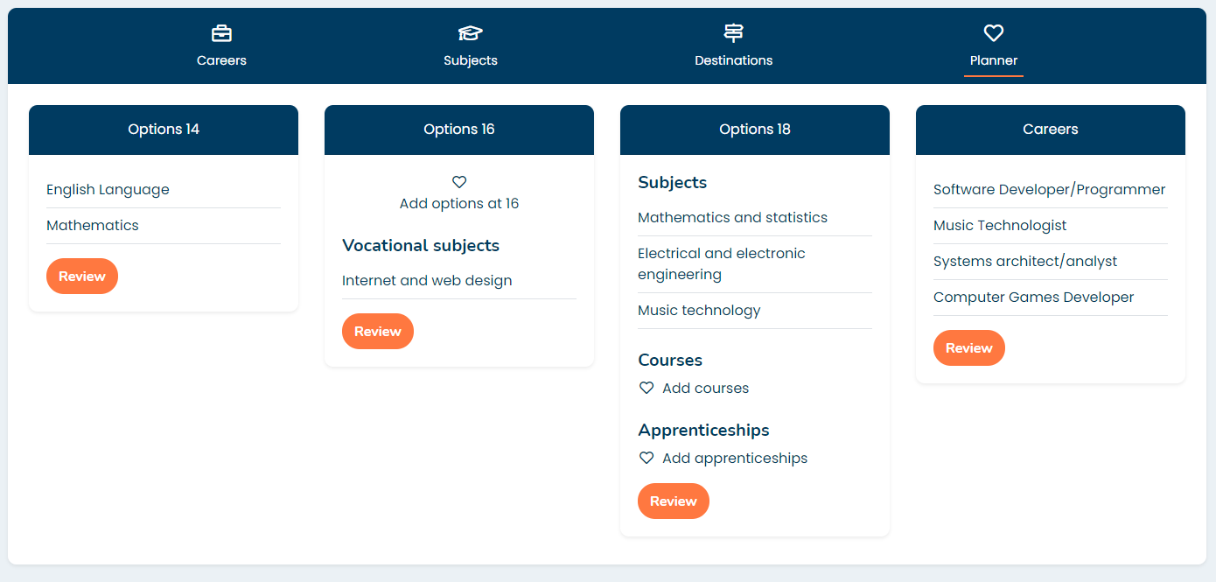
Progress - Action planning and next steps
Action planning tools
Planner section to store all favourites and shortlists

Slide 20
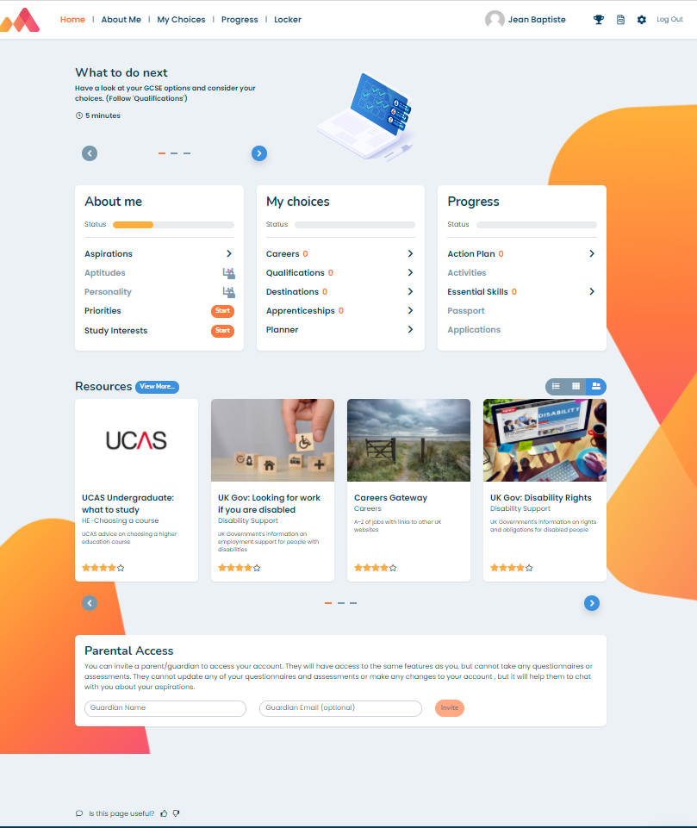
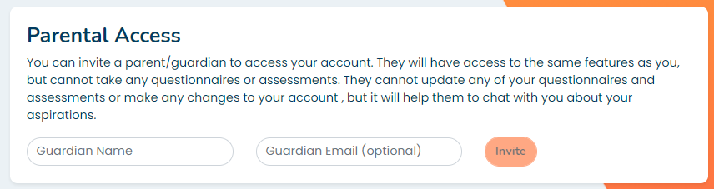
Parental access
View and navigate the site completely
Not able to take or retake assessments
On simple invitation by email
For more information visit www.morrisby.com

Slide 21
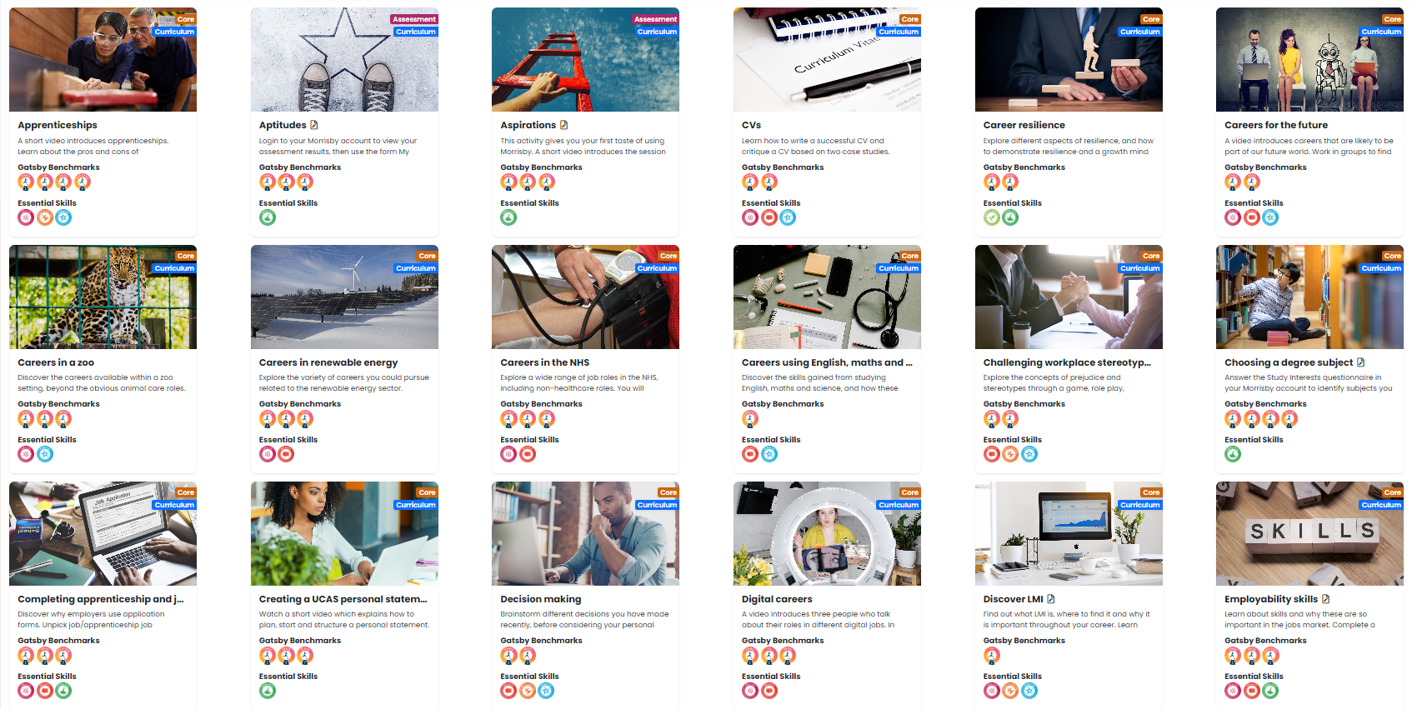
Built in career lessons
Full Careers Curriculum
Y7-13
44 lessons
Each including lesson plan, presentation and student resources
Mapped to CDI Framework, Gatsby and SkillsBuilder

Slide 22
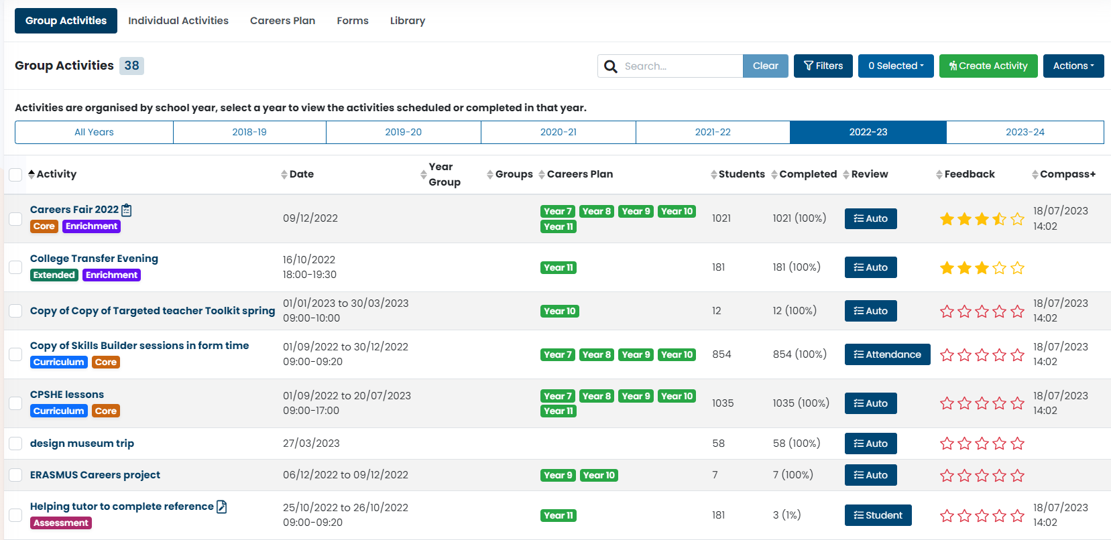
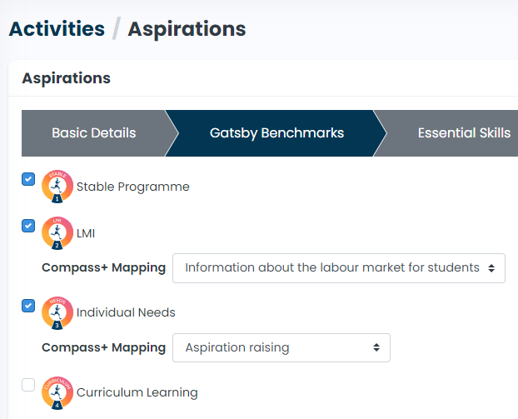
Activity recording and tracking
Assign any of the Morrisby Lessons or create your own activities
Record Career Assemblies, Careers Fairs, Open days, Mock Interviews, University visits
Add Gatsby benchmarks, Skills or your own Tags

Slide 23
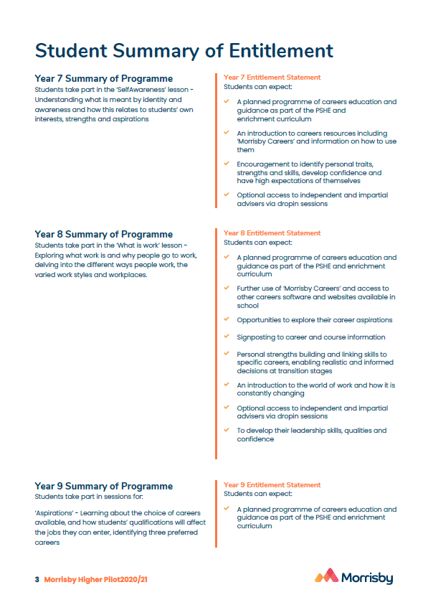
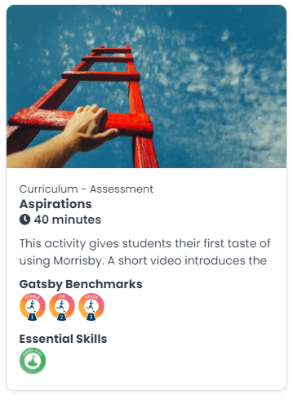
Careers Plan generation
Ready-made careers plan that you can simply edit
Default plan with 44 complete lessons and activities

Slide 24
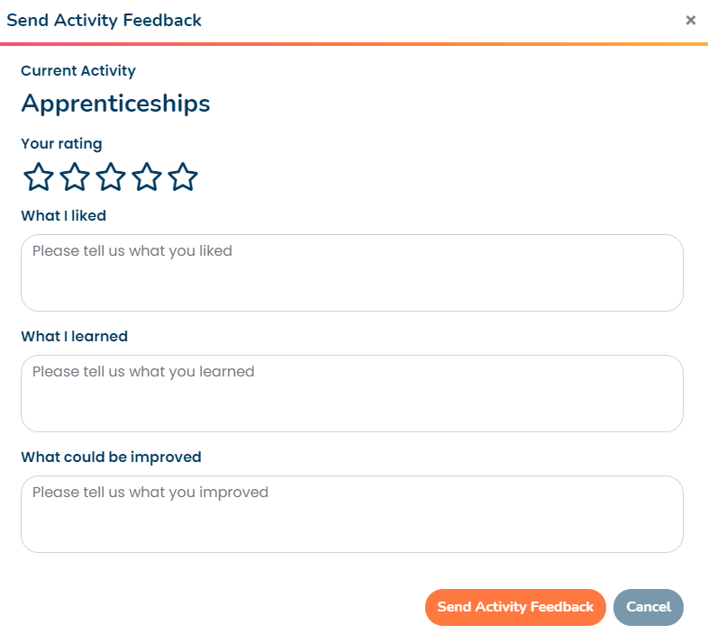
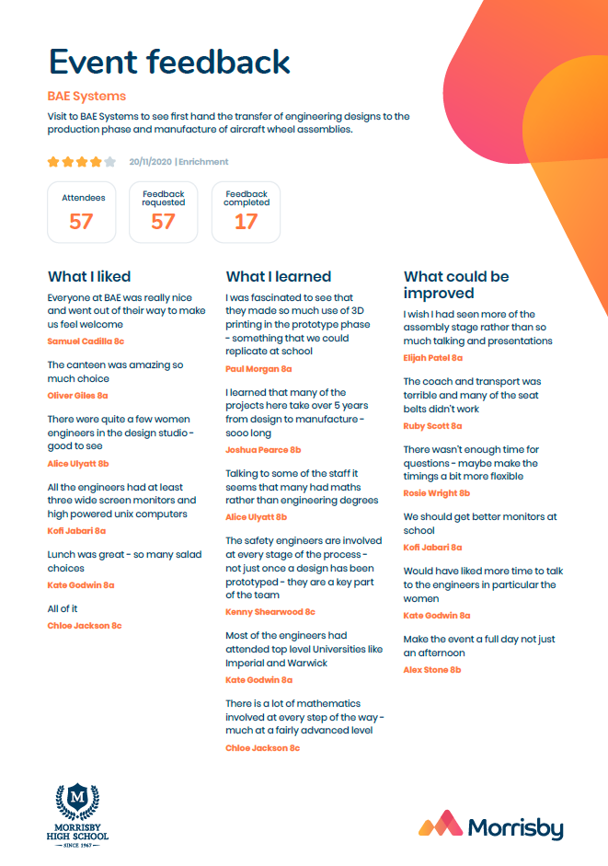
Feedback and student voice
Simple form (to replace all those slips)
Automatically collated making ideal evidence for inspection

Slide 25
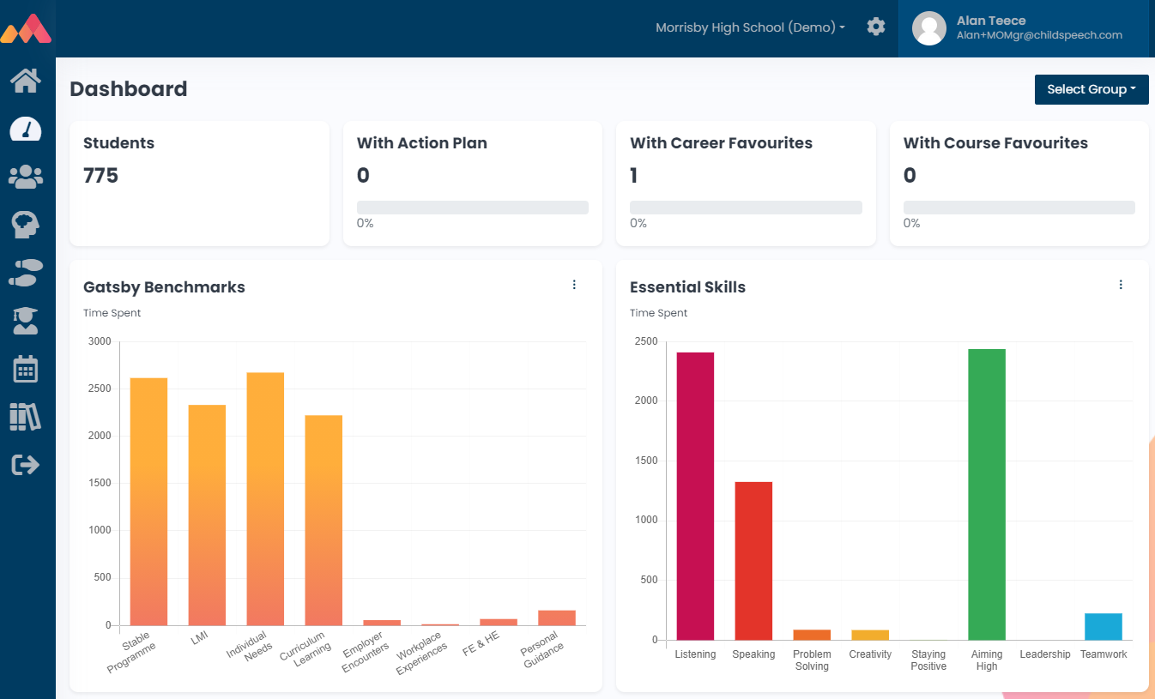
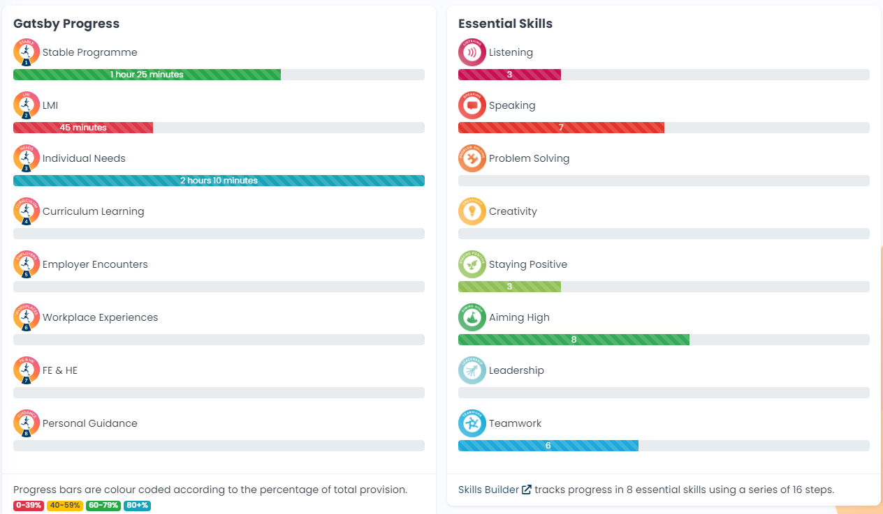
Data and Dashboards
Group and Student level data at a glance
Range of bulk pdf and csv downloads

Slide 26
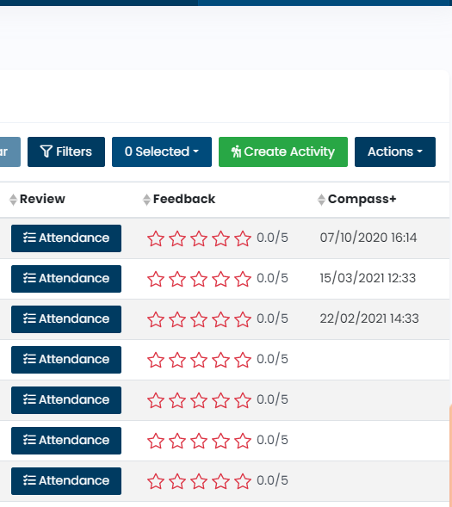
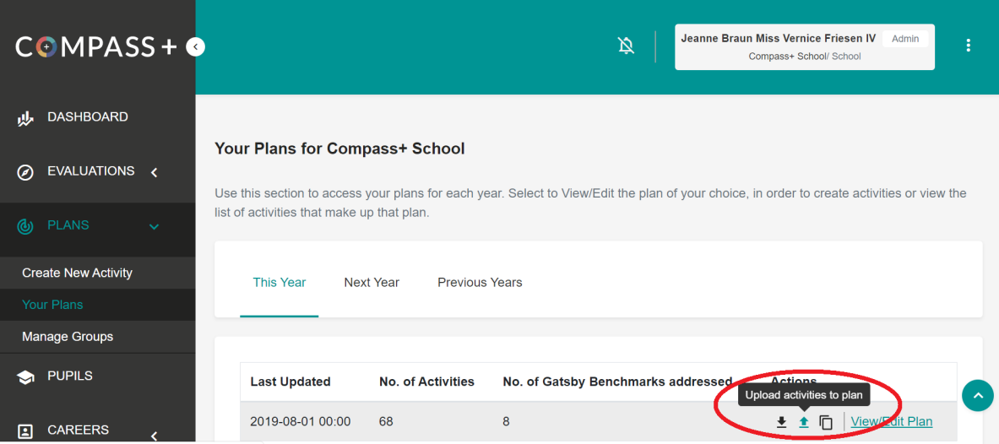
Data and Compass+
Export from Morrisby and Import to Compass+

Slide 27
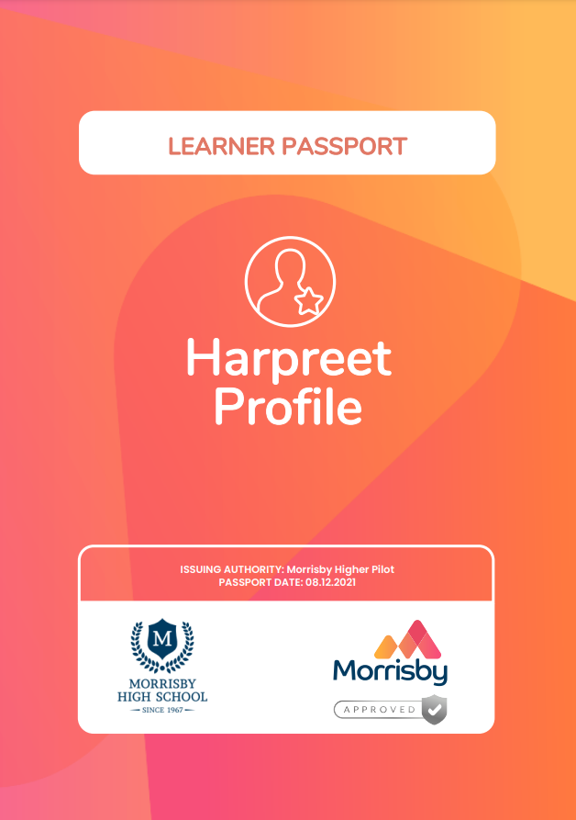
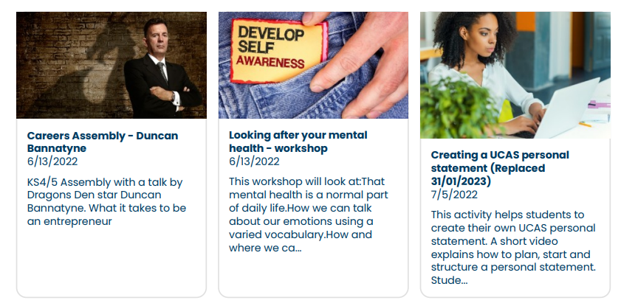
The output
Morrisby Learner Passport
Digital “Record of achievement”
Careers activities
Skills
Qualifications

Slide 28
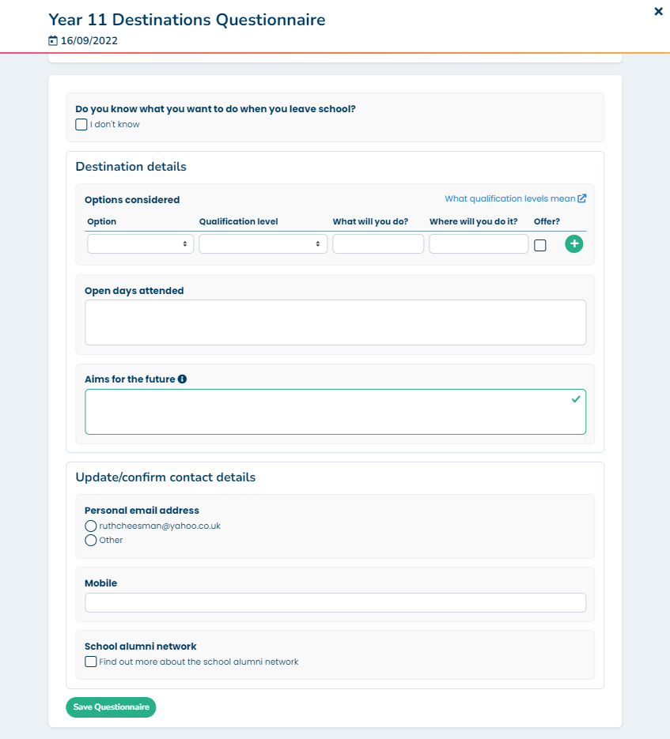
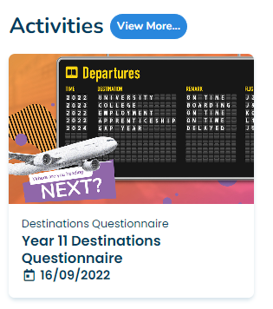
Student Destinations activity recording
Intended destinations for Y11,12 and 13
Student activity with email and app notifications
Students invited to find out more about Alumni
Invited to update or enter their (non-school) contact details

Slide 29
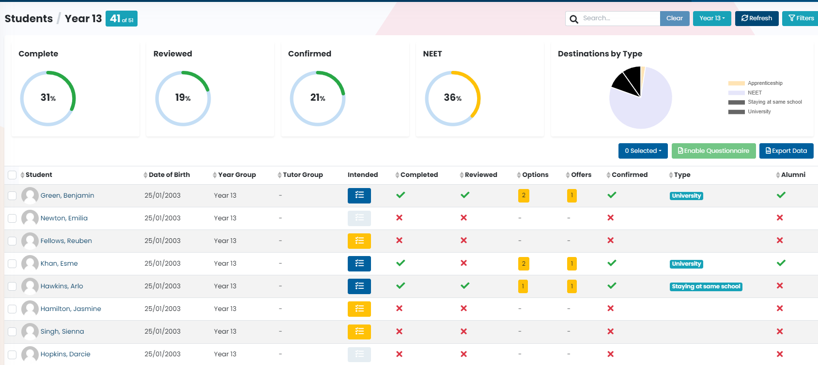
Destinations data management
Student Surveys
Tutors/Staff can review and update
Data can be exported as csv for further analysis and transmission to Local Authorities.

Slide 30
Morrisby Higher
Additional tools for sixth forms and Colleges
With up-to-date data from a variety of sources including UCAS, HESA, Office for Students and Times Higher

Slide 31
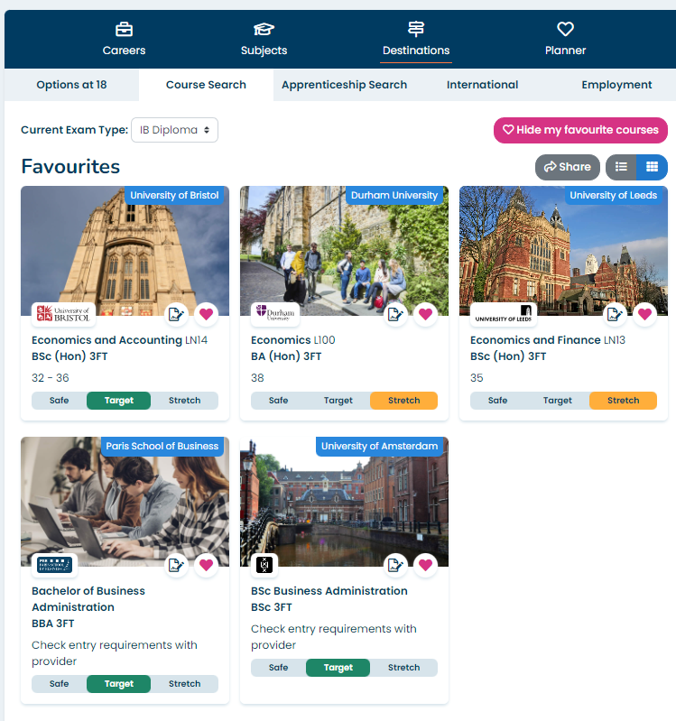
Enhanced student experience
Study interest questionnaire to help with course ideas
Detailed course information
Course comparisons
Shortlist output and sharing
Personal statement development

Slide 32
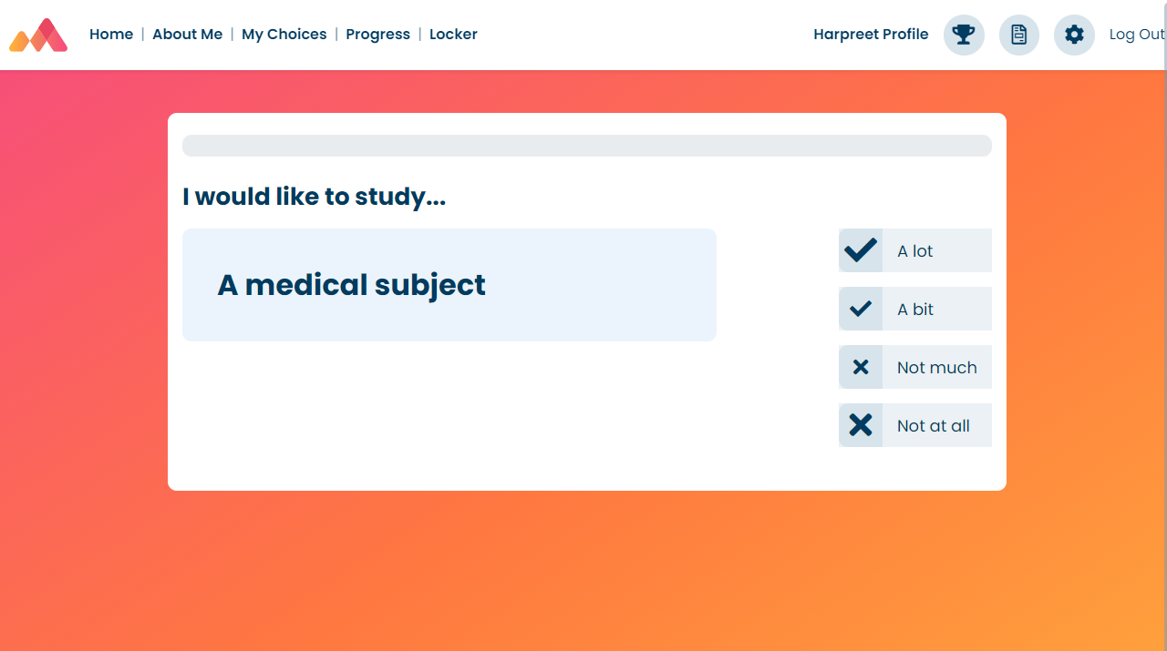
Study Interests questionnaire
Psychometric assessment that matches students to 150 Higher education subjects and adds to the assessments and questionnaires that have gone before

Slide 33
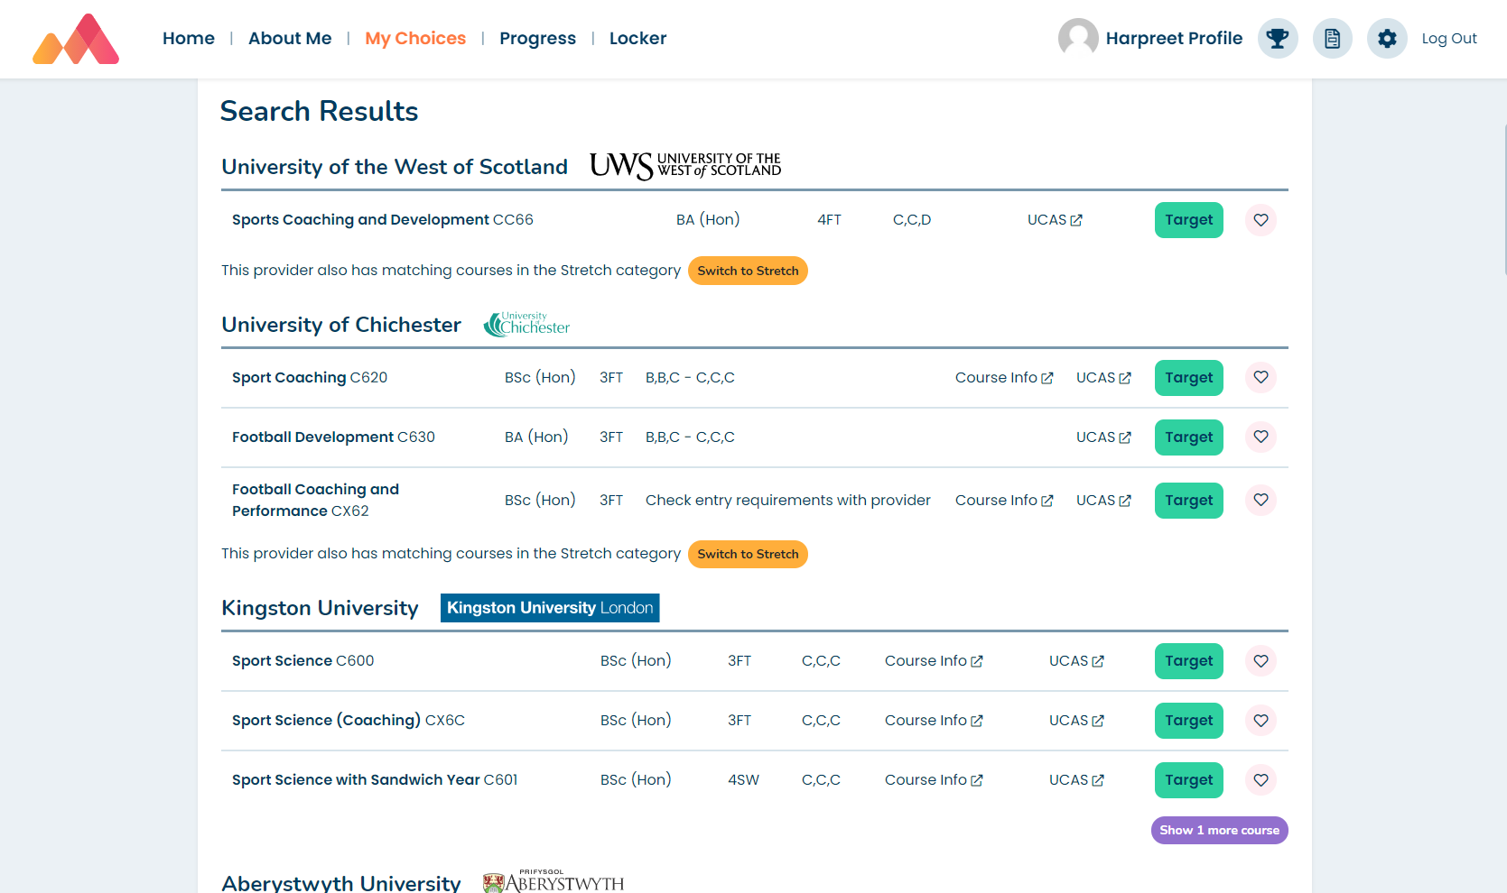
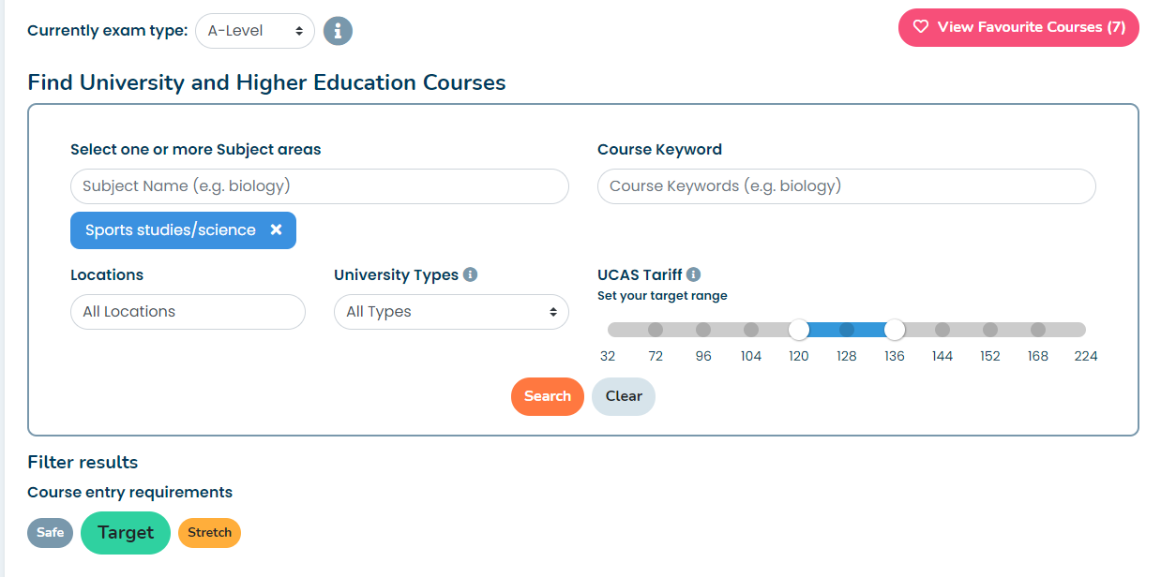
Enhanced course search
Safe
Target
Stretch

Slide 34



Course detail
Dedicated course page
Course comparison tool
Shortlists

Slide 35

Research – build and share a shortlist
View Courses – in categories
Research and then add to Favourites (shortlist)
Can then share (via email as a pdf)
Shortlist will also be in Locker

Slide 36



Oxbridge Tools
Overview information about Oxbridge
Detailed College profiles
College comparisons
Oxbridge Search within the course area

Slide 37


Personal statement wizard
Supported wizard or free form
Collaborative editing and “post-its”
Full audit trail
Output as text for UCAS or pdf

Slide 38

Predicted grades
Grade entry (range – high to low)
Alerts and notifications for any overdue
Ability to “Chase” staff

Slide 39


Academic references
Full management of academic reference process including new UCAS format
Output as text or pdf
Ability to “Chase” staff who are yet to provide references
Task list for staff

Slide 40

Data and dashboards
Dedicated Higher tab (to add to the other student info tabs)
Everything visible on one page including alerts for specialist subjects and status of references, personal statements and predicted grades
Additional information in the Student page

Slide 41
Morrisby Profile
Advanced Psychometric toolset
Detailed insight into student aptitudes and interests with career and course suggestions to make future pathways and options choices a better fit.

Slide 42
Morrisby Profile Objectives
You know what they want to do
You have little idea what to do?
How well researched are they?
Is it really appropriate?
How can they be so certain that they will be good at it?
At the very least, we may confirm their goals
OR, we may give them alternative new ideas about courses and careers they had never considered before
We assess their strengths, personality and interests
And match these to careers
Provide information on 600+ careers, including qualification requirements, salaries, videos, professional bodies & opportunities
Show them courses available & institutions (UK/Ireland/Europe)
But also allow modifying of results

Slide 43

Profile assessments
Verbal
Numerical
Abstract
Spatial ability
Mechanical ability
Attitudes
  Personality profile
  Aspirations
  Priorities
  Higher Education Study Interests covering 150 subject areas

Slide 44

Profile report
Detailed insight into strengths and preferences
Followed by career, subject and course suggestions
Downloadable report

Slide 45

Profile Interview
Explain what the tests measured and how the information was used
Ask student their perceptions of the results
Guide student about their career and subject options
Address any misunderstandings
Explain how to get the most from the features and tools to aid research
Consider the Profile and the student’s own circumstances to agree a realistic approach to careers
Agree future steps and actions
Record the outcomes on the interview system

Slide 46
Why Morrisby?
Student Self-Discovery
The World of Work and making the right choices
Streamline and improve careers admin
What makes me special?
Where are my strengths?
How do others see me?
What career paths should I consider?
What educational and training routes are best for me?
Develop and record life skills.
Understand the nature and variety of career opportunities.
Appreciate the breadth of options open to them in life.
Prepare positively for key decisions.
Research opportunities for themselves
Develop, publish and execute the school-wide career plan.
Mentor and support the entire student population.
Record activities against Gatsby, Skills & Compass+.
Manage UCAS and other transition processes
Prepare students for an independent, self-reliant future.

Slide 47
Work Experience
Full Placement management

Slide 48

Student experience
Self-Placement logging
Browse Placement Opportunities and then “Apply”
Placement verification
Placement attendance and feedback on the employer

Slide 49

Teacher experience
Add placements
Verify self-placements
Conduct comprehensive “Risk Management” to HSE standards
Monitor placement activity
Gather employer and student feedback.
Automation of tasks and alerts to avoid any oops moments

Slide 50

Employer experience
Add Business profile
Add placement opportunities
Easily add Health and Safety information
View student applicants so you can prepare
Monitor placement activity
Add feedback on students

Slide 51

Pricing
Any school signing up for a free trial and subscribes before end October 23 – 50% discount will apply

Slide 52
www.Morrisby.com sue.smith@morrisby.com

