Slide 1


KLEEK APPRENTICESHIPS
HAIRDRESSING - BEAUTY- BARBERING

Slide 2


ABOUT US
Kleek Apprenticeships is the UK's leading specialist hair and beauty training provider. Working with learners & salons in the Kent & Medway area.
We have over 24 years of experience working with apprentices and employers in the hair and beauty industry and have held an OUTSTANDING OFSTED rating for 17 years.
We are proud to have trained over 8000 apprentices and supported over 850 salons.

Slide 3

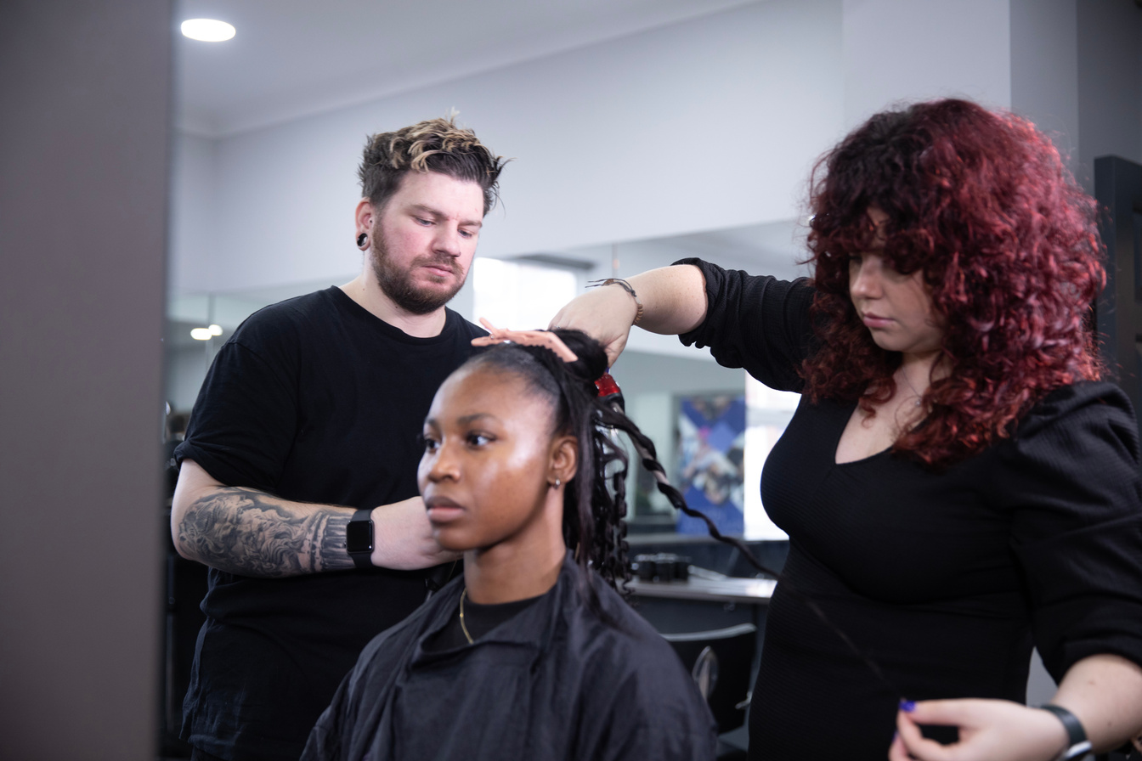
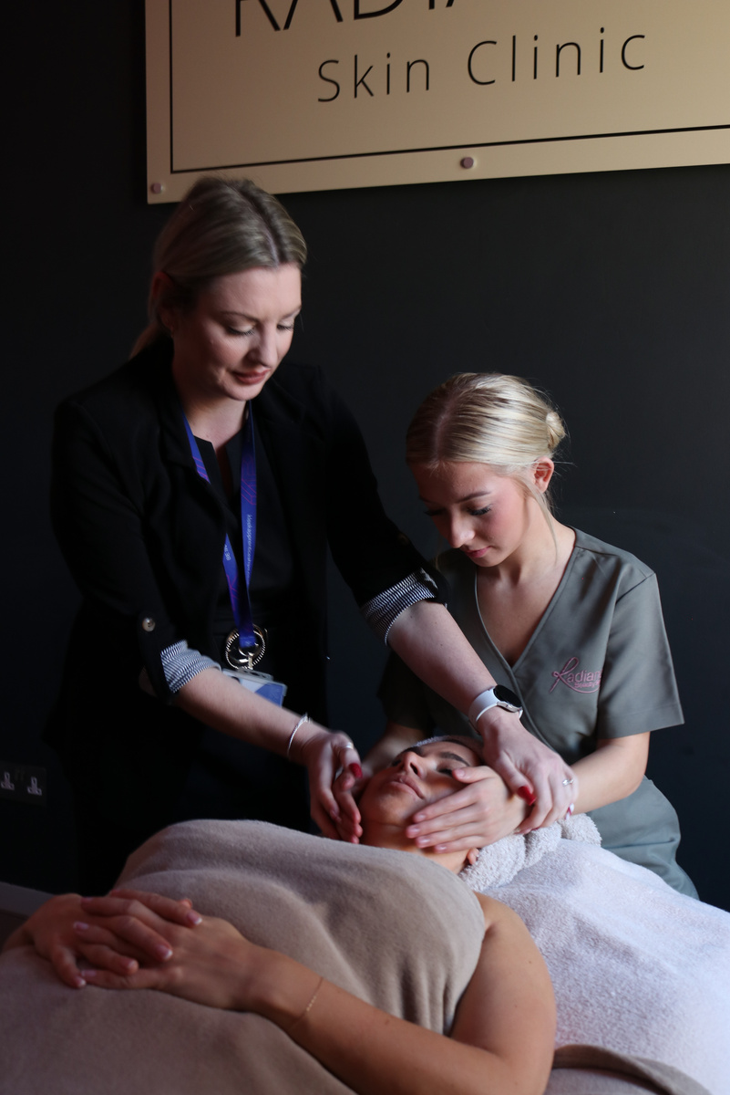
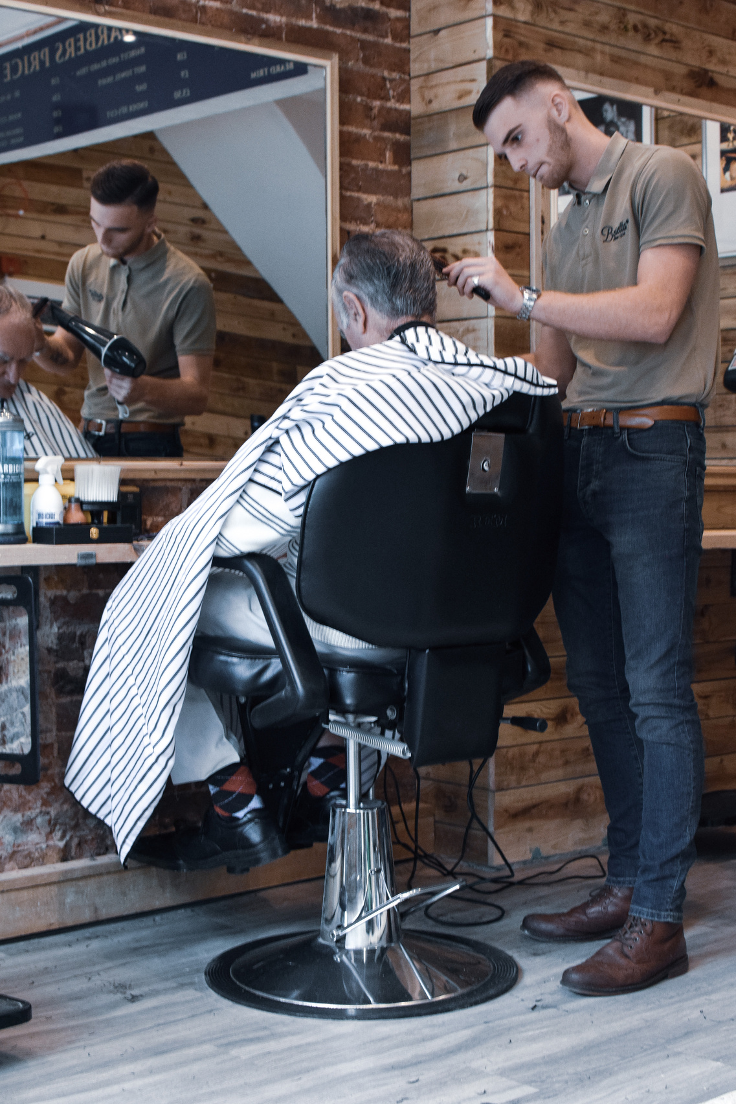
OUR APPRENTICESHIPS
HAIRDRESSING
The Level 2 Hairdressing Apprenticeship is the perfect starting point for all aspiring hairdressers. On completion you can progress onto the Level 3 Advanced Hairdressing Apprenticeship.
BEAUTY & WELLBEING
The Level 2 Beauty Therapist Apprenticeship is the entry level course for all beauty related careers after which you can choose to specialise with either the Level 3 Advanced Beauty Therapist or the Level 3 Wellbeing and Holistic Therapist apprenticeships.
BARBERING
The Level 2 Barbering Apprenticeship will provide you with the skills, knowledge and behaviours needed to excel in a barbering career.

Slide 4
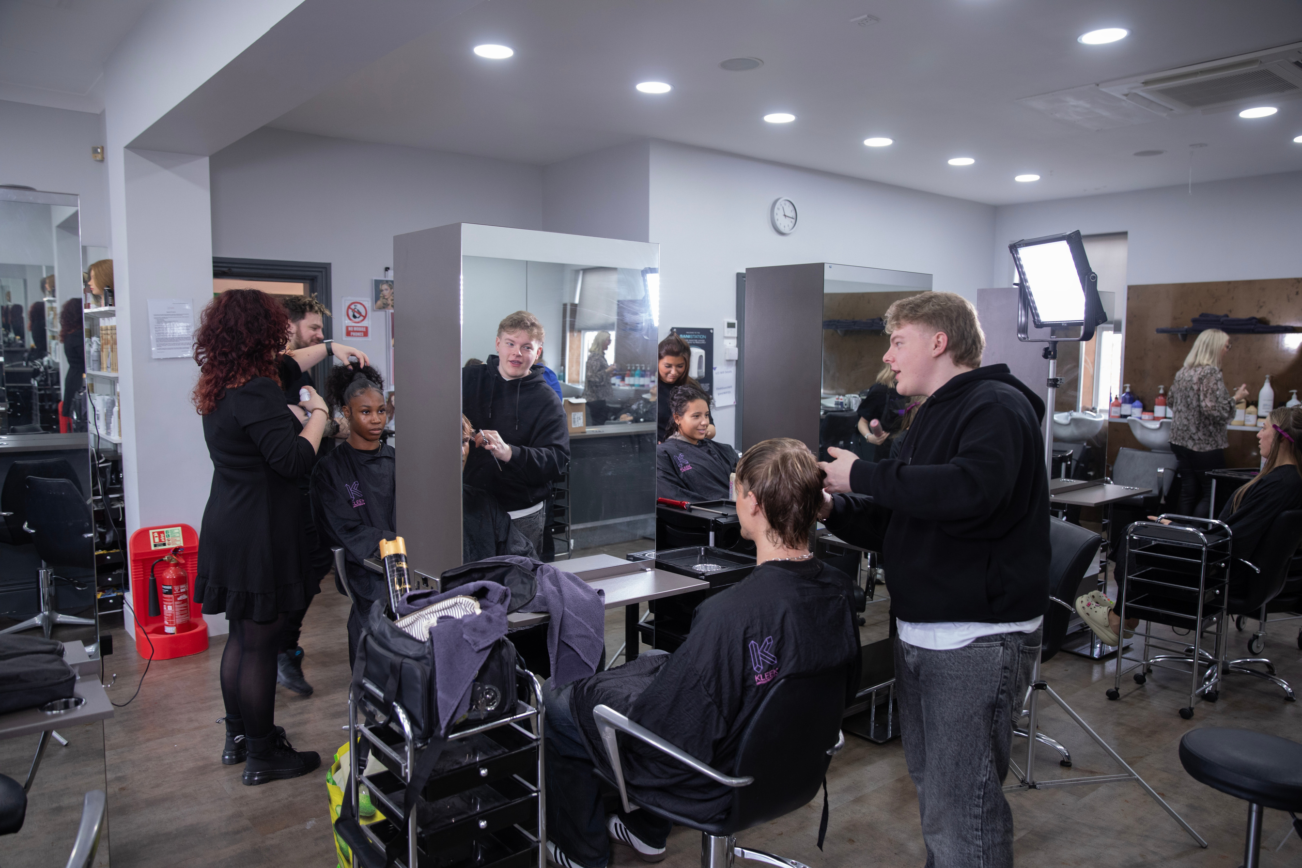
STARTING OUT
Starting an apprenticeship is as easy as 1,2,3!
Apply at any time throughout the year
and we will help find the perfect salon.
3) Once an employment has been secured, the learner will be assigned their own dedicated Educator who will deliver first-class training in our Maidstone Academy, or directly in the salon if not local to the Maidstone Academy.
1) Apply to Kleek Apprenticeships
2) Find An Employer

Slide 5
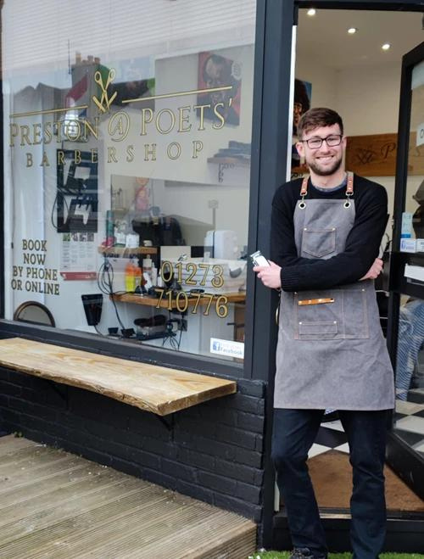
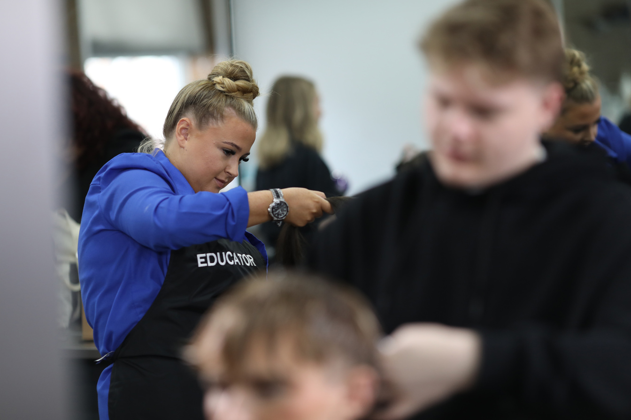
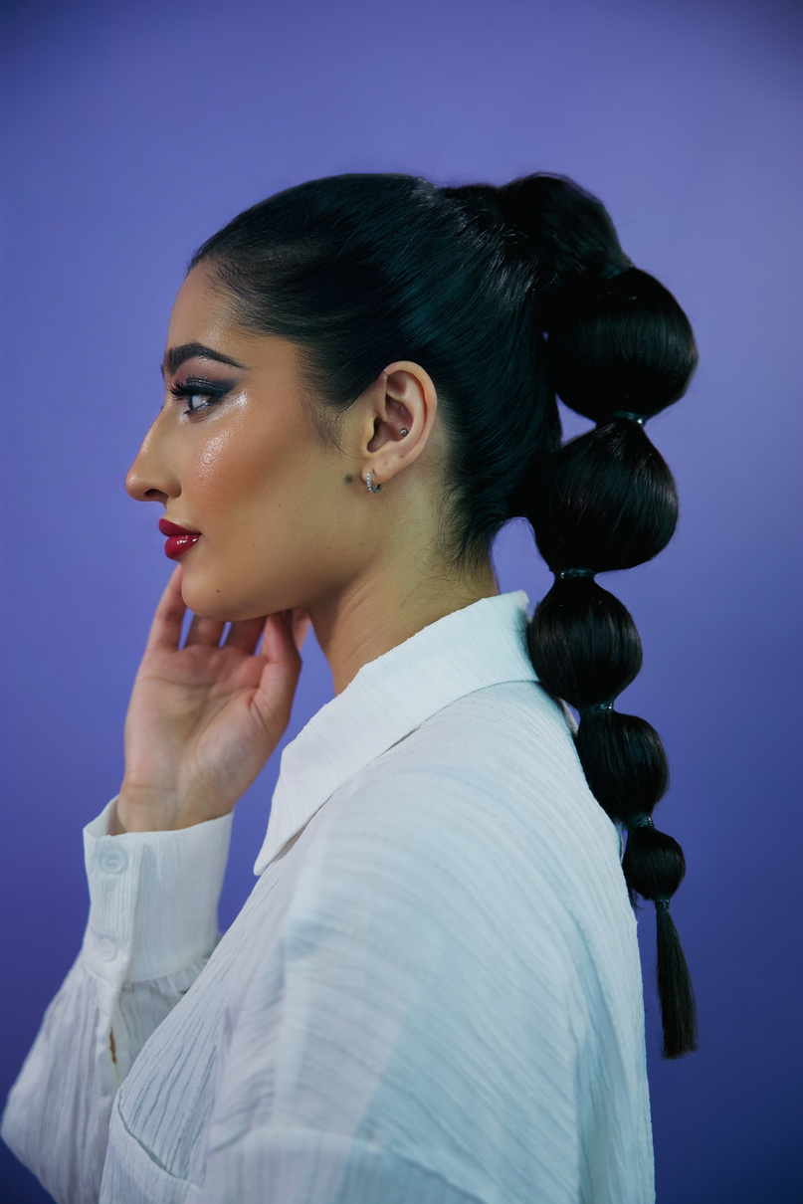
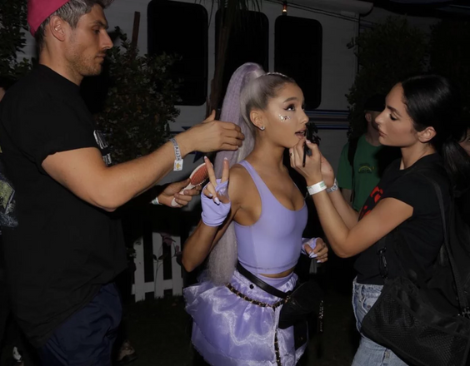

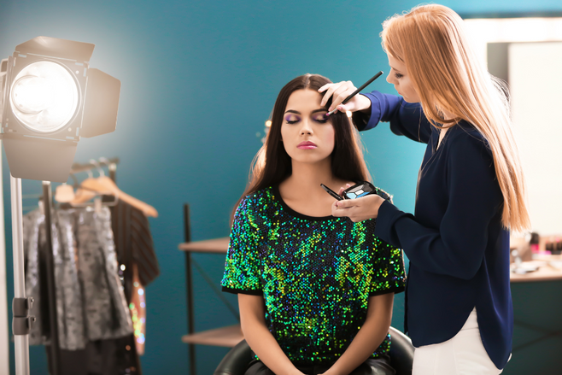
WHAT’S NEXT
HAIR, BEAUTY & BARBERING CAREER ROUTES
Become a Stylist, Barber or Therapist
Be The Boss
Teach the Next Generation as an Educator
Travel The World Working on Luxury Cruise Ships
Work with Celebrities in TV/Film/Theatre
Be an Influencer as a Brand Representative
Specialise as a..
Colour Specialist Massage Therapist Art Director
Session Stylist Nail Technician Make Up Artist

Slide 6
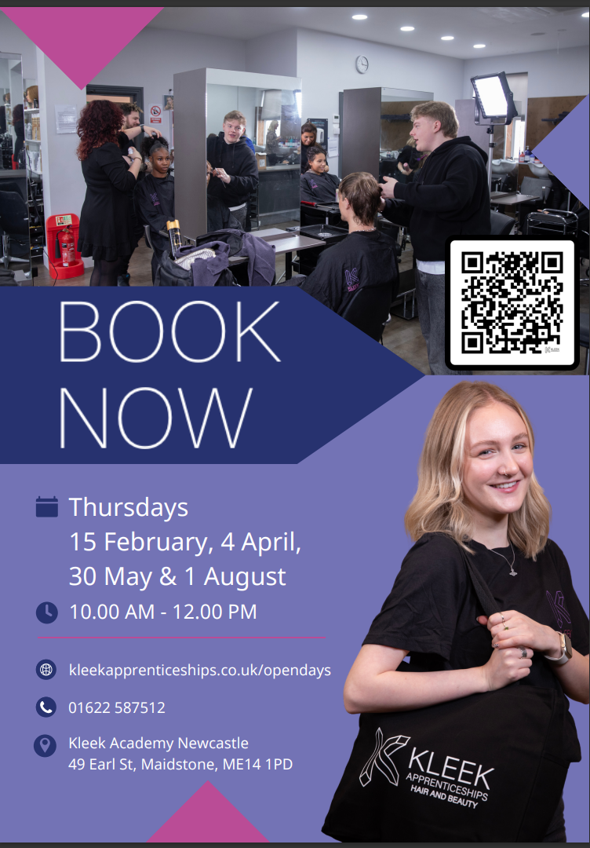
Academy Open Day

Slide 7
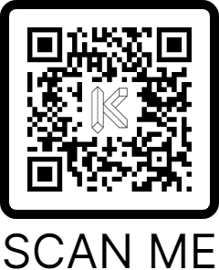

THANK YOU
If you have any questions, we’d love to hear from you at Kleek Academy Maidstone!
Kleek Academy Maidstone
49 Earl Street, Maidstone, ME14 1PD
01622 587512
or email madison@kleek.ac.uk
You can also find loads more information and guidance at
kleekapprenticeships.co.uk
BE PART OF THE KLEEK

