Slide 1
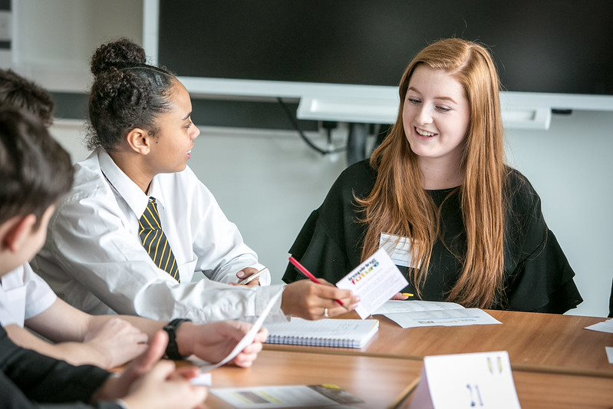


Slide 2


What is Inspiring the Future?
Meet Gatsby Benchmarks 3-7
Plan multiple in-person or virtual ​
encounters with exciting workplace volunteers
Free self-service network for state school and college staff
Access a range of accompanying pre-recorded resources and guides

Slide 3

Types of careers encounters:
CV Workshops
Mentoring
Mock Interviews
Work Experience
Sector themed
Career Talks
Speed Networking
Career Insights
Job Shadowing

Slide 4

Platform Demonstration

Slide 5



Next Steps
Access our 'How to Guides' to plan and deliver encounters
Create an activity to connect with volunteers
Sign up or login at www.inspiringthefuture.org
Notes:
Priority 2: Provide more high-quality experiences with employers for students and teachers – with a focus on current areas of need
Priority 1 – GB benchmarks, support, quality assurance, esp GB5 and GB6
Helping WLCH with Priorities 1 and 4 in their strategy

Slide 6
Thank you!
Contact us:
Email:
enquiries@inspiringthefuture.org
Call: 0207 566 4880
Sign up
www.inspiringthefuture.org

